Slide 1

Professional Boundaries & Prevention of Sexual Misconduct and Abuse
Dr. Russell Carlock, Research and Data Scientist

Slide 2
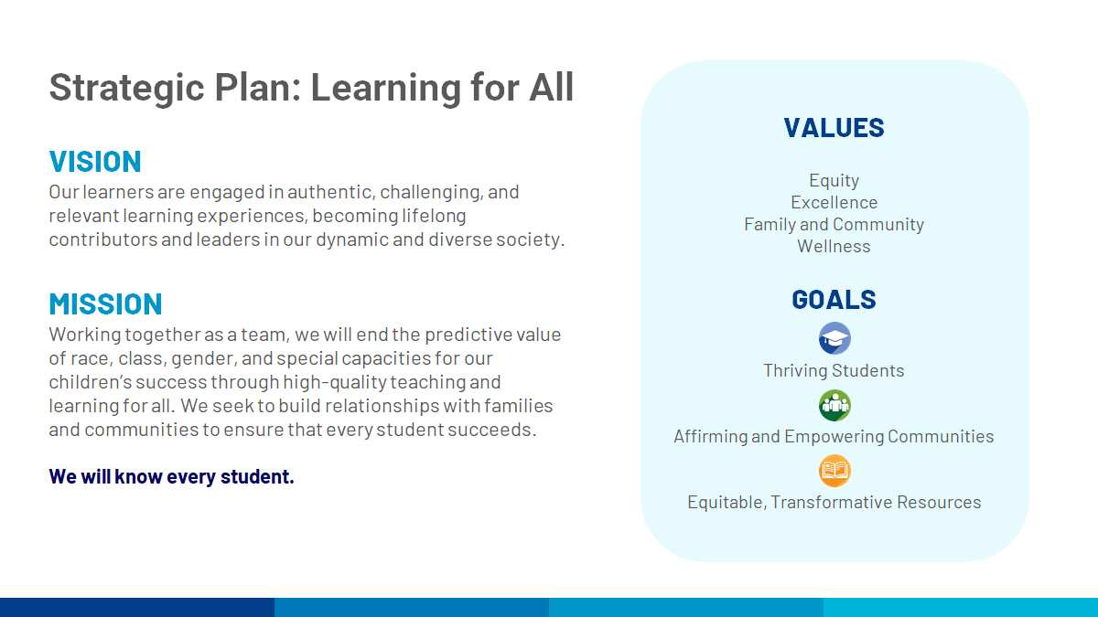

Slide 3

AGENDA
Key Issues in Public Feedback
Incorporated Changes
Questions/Discussion

Slide 4
Public Feedback
Preventing Educator Sexual Misconduct

Slide 5
Four Key Issues
Provide a Dual Reporting Structure
Reporting only to the building principal is insufficient.
Improve Definition of Emergency
Definition should be linked to issues of security/safety.
A Centralized Digital Log for Student Meetings
Logs must be easily accessible at the division level for monitoring and review.
Parental Notification in Founded Cases
Parents whose children had interactions with a staff member with a founded child abuse allegation should be notified, unless doing so would interfere with law enforcement.

Slide 6
Provide a Dual Reporting Structure
Section V. Reporting of Violations
Additionally, ACPS employees are required to report in writing suspected incidents of violations of this policy regarding professional boundaries, in-person, one-on-one, and electronic communications with students to the building principal and concurrently to the Human Resources Department. At the beginning of each school year, the principal will share this policy with parents/guardians and include contact information for the school’s human resources partner as a channel for reporting. A system for reporting concerns anonymously shall also be shared with the school community at the beginning of each school year.
Reports go concurrently to Human Resources and the Building Principal/Department Head.
An anonymous system (currently Helpme) will also be provided for reporting.

Slide 7
Improve Definition of Emergency
Section I. Definitions
D. Emergency Situation - an unanticipated, unavoidable operational necessity relating to health, safety, or security of an urgent nature requiring immediate action.
Link emergencies to issues of health, safety, and security.

Slide 8
Centralized Digital Log for Student Meetings
Section IV C. Limits on One-on-One Interactions
All adults shall document when one-on-one meetings occur with students in a division-managed digital system. This digital documentation system will be monitored by to principals, department heads, and division leaders and will be capable of producing lists of one-on-one meetings with students. Parents/Guardians shall be provided a list of one-on-one meetings with their child upon request of such list in writing directed to the building principal.
Requirement for documentation in centralized digital system, currently Branching Minds.
Meeting logs are available to parents/guardians upon request.

Slide 9
Notification for Founded Cases
Section IV C. Limits on One-on-One Interactions
When or if an adult (as defined in Section I of this Policy) is suspended or terminated for sexual molestation, physical or sexual abuse or rape of a child, or due to having become the subject of a founded case of child abuse or neglect, the Superintendent, or Superintendent's designee, shall inform the School Board, in writing, within 24 hours. The School Board shall determine whether the Superintendent will inform the families of ACPS students who may have come in contact with said adult, based on consultation with the Albemarle County Police Department and/or the Albemarle County Commonwealth's Attorney.
Requirement for notification of School Board for founded cases.
Parents to be notified upon law enforcement advisment that it will not impact their investigation.

Slide 10
Notification for Founded Cases
Section IV C. Limits on One-on-One Interactions
When or if an adult (as defined in Section I of this Policy) is suspended or terminated for sexual molestation, physical or sexual abuse or rape of a child, or due to having become the subject of a founded case of child abuse or neglect, the Superintendent, or Superintendent's designee, shall inform the School Board, in writing, within 24 hours. The School Board shall determine whether the Superintendent will inform the families of ACPS students who may have come in contact with said adult, based on consultation with the Albemarle County Police Department and/or the Albemarle County Commonwealth's Attorney.
Requirement for notification of School Board for founded cases.
Parents to be notified upon law enforcement advisment that it will not impact their investigation.

Slide 11
Counselors & Other Specialized Staff
Section IV C. Limits on One-on-One Interactions
Per Virginia Code 8VAC20-720-50 Licensed School Counselors may provide short duration personal or social counseling to students that is needed to maintain order, discipline, or a productive learning environment without affirmative parental consent.
For all other services with counselors, special educators, and other staff whose job duties include regular one-on-one meetings with students, staff will provide parents with an annual notification that describes the services provided and the parameters under which any one-on-one meetings take place as part of those services. Parents shall be able to opt-out of these services by returning the form documenting their decision to the building principal or designee.
Limited exemption to parental consent for counselors.
Requires beginning of the year notification and opt-out for staff who regularly meet one-on-one with students.

Slide 12
One-on-One Electronic Communications
Section IV E. Electronic Communications
Adults must restrict one-on-one, electronic communications with individual students to accounts, systems, and platforms that are provided by and accessible to Albemarle County Public Schools. These systems must provide access to parents/guardians to observe all communication with their child. In the case of a communication system that does not automatically allow access to parents/guardians (e.g., email), the parent/guardian must be included in the communication. If an adult must contact a student via email and their parent's email is unavailable, the adult shall include their direct supervisor in the communication. Adults shall not use personal phones to communicate with students unless using an application provided by ACPS that allows for accessibility to parents/guardians.
If a parent’s email is unavailable, staff must include their supervisor in the communication.

Slide 13
Questions/Discussion

